Slide 1
Business-to-Business Markets:
How and Why Organizations Buy
Chapter Five

Slide 2
Chapter Objectives
Understand the characteristics of business-to-business markets, business-to-business market demand, and how marketers classify business-to-business customers
Appreciate opportunities for using e-commerce and social media in business-to-business settings
Identify and describe the different business buying situations and the business buying decision process
Copyright © 2013 Pearson Canada Inc.
5-<number>
Notes:
p. 150
LECTURE NOTES:
After finishing this chapter, you should be able to:
Understand the characteristics of business-to-business markets, business-to-business market demand, and how marketers classify business-to-business customers
Appreciate opportunities for using e-commerce and social media in business-to-business settings
Identify and describe the different business buying situations and the business buying decision process

Slide 3
I. Understand the characteristics of business-to-business markets, business-to-business market demand, and how marketers classify business-to-business customers
Copyright © 2013 Pearson Canada Inc.
5-<number>
Notes:
This slide relates to Learning Objective (hereafter LO) #1 of chapter 5.

Slide 4
Business Markets: Buying and Selling When the Customer is Another Firm
Business-to-business marketing
    The marketing of goods and services that businesses and other organizations buy for purposes other than personal consumption
Business-to-business markets
    The group of customers that include manufacturers, wholesalers, retailers, and other organizations
    Also known as organizational markets
Copyright © 2013 Pearson Canada Inc.
5-<number>
Notes:
This slide relates to LO #1 of chapter 5.
p. 150
LECTURE NOTES:
Business-to-business (B2B) marketing is a critical, though less visible form of many firm’s marketing efforts. For example, we tend to think of Proctor and Gamble as a consumer goods manufacturer and marketer. Without B2B marketing efforts to retailers and wholesalers, P&G would have no way of reaching the ultimate consumer.
Business-to-business (organizational) markets include manufacturers, wholesalers, retailers, and other organizations such as hospitals, and government. Organizations purchase goods and services for one of three reasons: 1) for use in operating the business (chairs, desks, copy machines, paper, toner, pens, etc.); 2) to include as a part or ingredient in something else (raw materials such as grain, component parts such as tires, or memory boards); or 3) for resale (wholesalers/retailers purchase goods to resell to ultimate consumers).

Slide 5
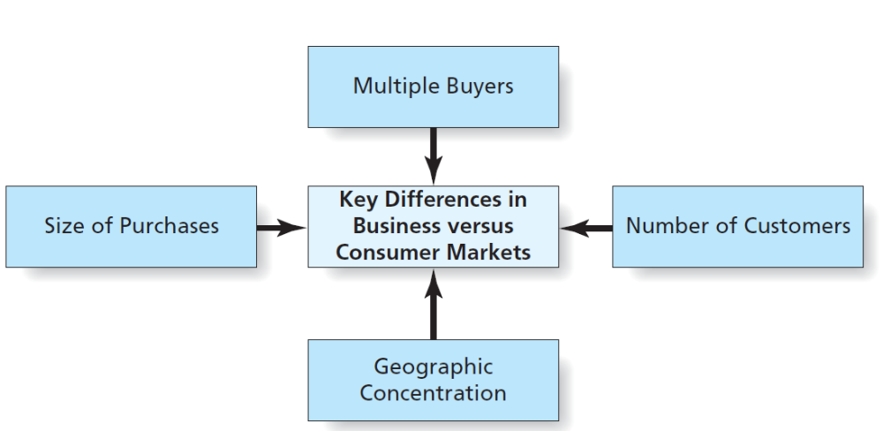
Figure 5.1
Key Differences in Business Versus Consumers Markets
Copyright © 2013 Pearson Canada Inc.
5-<number>
Notes:
This slide relates to LO #1 of chapter 5.
p. 151
LECTURE NOTES:
Although marketing to business customers has some things in common with consumer marketing, there are several important differences that make the entire buying process more complex.

Slide 6
Factors That Make a Difference in the Business Markets
Business markets differ from consumer markets in four key aspects
Multiple buyers
    Decisions are made by multiple buyers, called decision groups or buying center
Number of customers
    Fewer business customers
    0.5 million business & not-for-profit organizations vs. 15 million consumer households
Copyright © 2013 Pearson Canada Inc.
5-<number>
Notes:
This slide relates to LO #1 of chapter 5.
p. 152
LECTURE NOTES:
Business markets differ from consumer markets in four key aspects

Slide 7
Factors That Make a Difference in the Business Markets (ctn’d)
Size of Purchases
    Purchases involve high costs and large quantity of items
Geographic concentration
    Business customers are located in a small geographic area, rather than being spread out across the country
Copyright © 2013 Pearson Canada Inc.
5-<number>
Notes:
This slide relates to LO #1 of chapter 5.
p. 153

Slide 8
B2B Demand
Demand in business markets differs from consumer demand
Demand for B2B products is
  Derived
  Inelastic
  Fluctuating
  Joint
Copyright © 2013 Pearson Canada Inc.
5-<number>
Notes:
This slide relates to LO #1 of chapter 5.
p. 153
LECTURE NOTES:
Aside from the fact that demand is derived, B2B demand also differs from consumer demand in that it is characterized as being inelastic, fluctuating, and joint. Each of these demand characteristics will be discussed in more detail on the following slides.

Slide 9
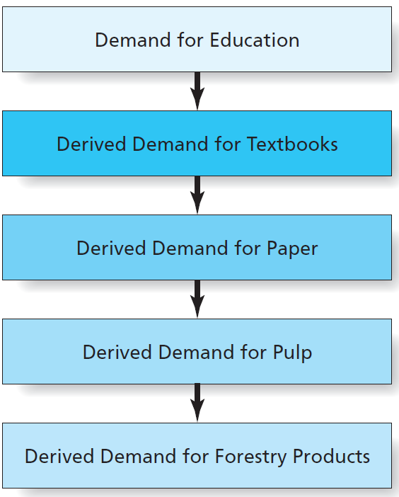
Figure 5.2
Derived Demand
Derived demand
  Demand is derived directly or indirectly from consumer demand for another good or service
Copyright © 2013 Pearson Canada Inc.
5-<number>
Notes:
This slide relates to LO #1 of chapter 5.
p. 153
LECTURE NOTES:
Demand for B2B products also differs from demand for consumers demands. One of the most important differences is the fact that B2B demand is derived, meaning that it stems directly or indirectly for consumer demand for another good or service.
The example shown here illustrates how consumer’s demand for an education influences derived demand for a number of goods, including textbooks, paper, pulp, and forestry products. Thus demand for a single consumer product may contribute to the derived demand of many B2B goods.
DISCUSSION NOTES:
The threat of substitution is always present when dealing with business demand, and probably should be addressed during the discussion of this slide. For example, you might point to the exhibit on this slide and ask students to consider what substitutes exist for paper textbooks (digital books, online learning centers, or course, etc.). Obviously, if demand were to shift radically toward digital books, it would influence the derived demand for forestry products in a negative manner. (Which might not be a bad thing when considered from a sustainability perspective.)

Slide 10
Business-to-Business Demand
Inelastic demand
    Changes in price have little or no effect on the amount demanded
Fluctuating demand
    Small changes in consumer demand create large increases or decreases in business demand
    Life expectancy of the product can cause fluctuating demand
Copyright © 2013 Pearson Canada Inc.
5-<number>
Notes:
This slide relates to LO #1 of chapter 5.
p. 153 – 154
LECTURE NOTES:
Inelastic: this means that it usually doesn’t matter whether the price of a B2B good goes up or demand – businesses will still buy in the same quantity. This is particularly true when the component or raw material being purchased is just one of many parts or materials that go into creating the product, so the cost of the final product to the consumer is unlikely change (and thus unlikely to influence the level of derived demand.
However, B2B demand can become elastic if the cost of a price increase is passed on to consumers.
Fluctuating : Demand for business goods is also subject to greater fluctuation than is consumer demand. Why?
First of all, even a modest change in consumer demand can create large increases or decreases in business demand, as businesses postpone or cancel orders in response to declines in consumer demand.
Secondly, business customers tend to buy certain products infrequently, such as major equipment used in manufacturing facilities which may be replaced only once every 10 to 15 years. Thus demand may be high one year, if it just so happens that a lot of firms buy replacement equipment at that time, but low the following year if fewer firms are in the market for replacement goods.

Slide 11
Business customers tend to buy certain products infrequently, such as major equipment used in manufacturing facilities which may be replaced only once every 10 to 15 years

Slide 12
Business-to-Business Demand
Joint demand
    Demand occurs for two or more goods that are used together to create a product
  Examples?
  {computers: motherboards, RAM chips, hard drives, etc.}
Copyright © 2013 Pearson Canada Inc.
5-<number>
Notes:
This slide relates to LO #1 of chapter 5.
p. 154
LECTURE NOTES:
Joint: Many business goods are characterized by joint demand, meaning that demand is linked between two or more goods, parts, or components that are used together to create a product. Can you give me an example? {computers: motherboards, hard drives, etc.}

Slide 13
It’s Debatable
Class Discussion Question
Suppose that the price of a key component used in your product has unexpectedly tripled. E.g. price of tire. Think about the pros and cons of each of the following potential actions. Where do you stand?
  1) Pass the price increase onto the customer
  2) Absorb the price increase
  3) Change vendors and purchase a lower-priced alternative part instead
Copyright © 2013 Pearson Canada Inc.
5-<number>
Notes:
This slide relates to LO #1 of chapter 5.
DISCUSSION NOTES:
Students may be eager to explore options 1 and 3, after learning the key component price has tripled in price. However, it might be worthwhile pointing out that several factors should be considered prior to making this decision:
Whether the cost increase is forecast to be temporary or permanent. Obviously a firm would be more likely to absorb the price increase if it is forecast to be temporary
Percent of the overall product cost which can be contributed to the key component. If the cost of the component represents only a fraction of the overall product costs, it may not be necessary to pass on the price increase
Importance of component quality and relative quality level provided by alternative vendors. Since it is a key component, comprising quality for a lower cost, may not be the best solution.

Slide 14
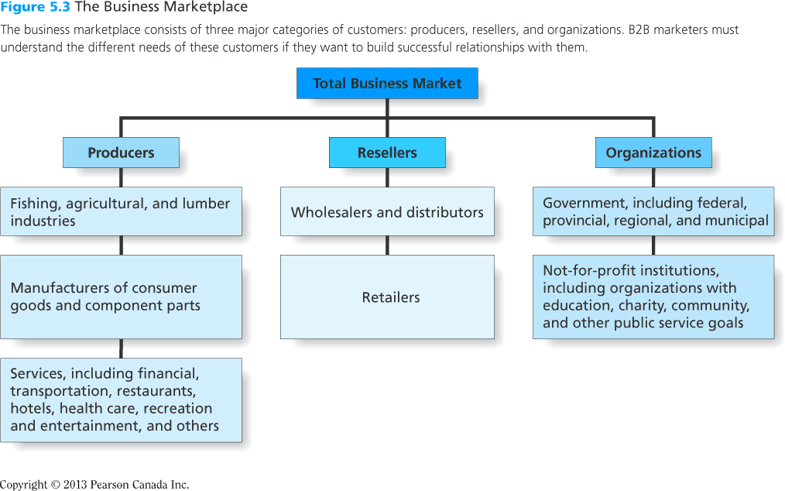
Figure 5.3
The Business Marketplace
Copyright © 2013 Pearson Canada Inc.
5-<number>
Notes:
This slide relates to LO #1 of chapter 5.
p. 155
LECTURE NOTES:
Three major classes of B2B customers include producers, resellers, and organizations.
Producers are individuals or firms that purchase products for use in the production of other goods and services. The goods purchased may be raw materials, component parts, semi-finished goods, or services.
Examples:
A) Dell buys RAM chips from Intel for integration into their PCs;
B) General Mills buys grains to be used in the manufacture of cereals from ;
C) A travel incentive provider purchases hotel rooms, tickets to entertainment venues, and flights, then creates incentive packages that are sold to business corporations looking to reward employees who performed well.
Resellers are individuals or firms that buy finished goods for reselling, renting, or leasing. Resellers include wholesalers, distributors, and of course retailers.
Examples:
A) Wholesalers/distributors: Sysco supplies hospitals, educational institutions, and other organizations with a variety of paper goods (napkins, toilet paper, etc.), ingredients (salt, sugar, etc.) and other items.
B) Students should be able to come up with a variety of retailer examples quite easily.
The Organizational market includes all levels of government and not-for-profit institutions. Federal, provincial, regional, and municipal governments that buy goods and services to carry out public objectives and to support their operations. Organizations with charitable, educational, community, and other public service goals that buy goods and services to support their functions and to attract and serve their members.
Dealing with government markets is very different than dealing with other types of organizations, and for that reason many large firms maintain separate divisions that are tasked with dealing only with Government buyers.
Some of the key differences include the fact that government purchasing often is restricted to a list of approved vendors, and even those vendors may need to bid for projects, or agree to a contract in which a fixed price is guaranteed over a given period of time, usually a year. Although the size of the government market is attractive, unanticipated changes such as drastic increases in the cost of fuel can limit the profit potential of the market, and come back to haunt suppliers who are required by contract to fill orders at a predetermined price (if that price includes delivery).
Another key difference is that government purchasing agents are not allowed to accept gifts—accepting even the must mundane promotional item (such as pen, cap, or mouse pad) is illegal, and salespeople who (knowingly or unknowingly) offer such items to government buyers run the risk of being thrown out the door, being accused of bribery, or perceived as an unethical.
Examples:
A) The federal government purchases military weapons systems, furniture for offices, copy machines, supplies, and services such as construction. State and local governments purchase many of the same items (with the exception of the cruise missile and other major military weapons).
B) Not-for-profits purchase printing services to create educational brochures, supplies and products for distribution to charity recipients, and items to be used at their place of business.

Slide 15
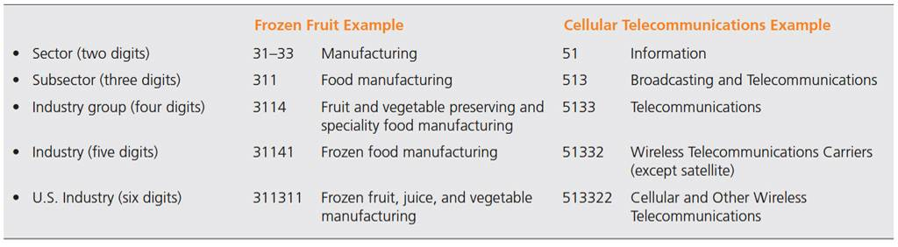
Table 5.2
North American Industry Classification System
NAICS
  The numerical coding system that the US, Canada, and Mexico use to classify firms into detailed categories according to their business activities
Copyright © 2013 Pearson Canada Inc.
5-<number>
Notes:
This slide relates to LO #1 of chapter 5.
p. 156
LECTURE NOTES:
NAICS is a numerical coding of industries in the United States, Canada, and Mexico. Sectors form the broadest level of the NAICS classification system, and are represented by the first two digits. This system is very useful for B2B marketers, as this can be used to help identify new B2B customers.
Table 5.2 provides two examples of the NAICS in action.

Slide 16
II. Appreciate opportunities for using e-commerce and social media in business-to-business settings
Copyright © 2013 Pearson Canada Inc.
5-<number>
Notes:
This slide relates to LO #2 of chapter 5.

Slide 17
Business-to-Business
E-Commerce and Social Media
B2B E-Commerce
Internet exchanges between two or more businesses or organizations
  Facilitates exchanges
  Links marketers to value chain members
  Internet site is critically important
Copyright © 2013 Pearson Canada Inc.
5-<number>
Notes:
This slide relates to LO #2 of chapter 5.
p. 157
LECTURE NOTES:
B2B E-Commerce refers to Internet exchanges between two or more businesses.
It facilitates exchanges, such as exchanges of information, goods, service, and payments.
Another benefit of using the Internet for e-commerce it that it links businesses with their suppliers, factories, distributors, and their customers
The simplest form of is B2B ecommerce occurs when the firm’s web site offers an online catalogue of items available for sale.
Of course these internet sites are also instrumental in providing B2B technical support, item/order status information, and customer service

Slide 18
Intranets, Extranets, and Private Exchanges
Intranets
    An internal corporate computer network that links a firms’ departments, employees, and databases
Extranets
    A corporate computer network that allows authorized suppliers, customers, and other outsiders to access the firm’s internal system
Private exchanges
    Systems that link an invited group of suppliers and partners over the Web
Copyright © 2013 Pearson Canada Inc.
5-<number>
Notes:
This slide relates to LO #2 of chapter 5.
p. 157 - 158
LECTURE NOTES:
While the Internet is the primary means of offering B2B e-commerce, many firms also use intranets, extranets, and private exchanges for e-commerce purposes.
Intranets are generally more secure, as only authorized users can gain access. Because intranets are internal, transactions are more consistent and conducted under enhanced security than is typically found on Internet based web sites.
Intranets can also be used for video-conferencing or training purposes, for communication with both on- and off- site employees, and as a document repository.
Extranets allow certain suppliers or customers to access the firm’s intranet.
This is often beneficial as it allows customers to place and track their own orders, enhancing their satisfaction
This self-serve feature also means that extranets are very cost-efficient, as any actions taken by customers are suppliers saves time, effort, and cost on the part of the extranet provider.
A final benefit of extranets is that they facilitate project collaboration, and help build relationships up and down the value chain.
Private exchanges are more appropriate for businesses that want to collaborate or share information with invited suppliers or customers, but NOT others.

Slide 19
The Dark Side of B2B E-Commerce
Hackers threaten security
    Credit card number theft
    Firm records destroyed, trade secrets stolen
    Authentication is critical
      Ensure only authorized individuals are allowed to access a cite
Well-meaning employees can create security problems
Firewalls and encryption safeguard
e-commerce transactions
Copyright © 2013 Pearson Canada Inc.
5-<number>
Notes:
This slide relates to LO #2 of chapter 5.
p. 158
LECTURE NOTES:
The large amount of data which passes through the Internet also creates the potential for security risks. Hackers are continually finding new ways to access a variety of data, include customer credit card numbers and other personally identifiable information that may result in the theft of a consumer’s identity.
However, hackers also can destroy the records of the firm, or steal trade secrets.
Firms use authentication procedures to try and protect against hacking, meaning that electronic processes attempt to limit access to only authorized users.
You may be surprised to learn that well-meaning employees can also be security threats when they are careless with passwords or otherwise engage in some type of behavior that assists (unintentionally) unauthorized users in gaining access.
To help protect against problems of this natures, most firms use a combination of hardware and software, called a firewall, that helps to prevent non-authorized users from gaining access to things they shouldn’t
Encryption devices also help to maintain security, as the scramble messages so that only another party with the proper encryption key can unscramble it.

Slide 20

B2B and Social Media
Games generate buzz and drive brand awareness
B2B marketers use social networking sites to promote themselves
Linked In is the most prominent social networking site for B2B marketers and offers several advantages
SLOBs – Office Depot
Linked In
Copyright © 2013 Pearson Canada Inc.
5-<number>
Notes:
This slide relates to LO #2 of chapter 5.
p. 159 - 160
LECTURE NOTES:
The use of social media in the B2B marketplace is growing. Games are being used by some B2B marketers to appeal to their customers.
For example, Office Depots “Strange Little Office Beings” (SLOBs) let visitors create their own office being and then challenge other SLOBs to duels. Visitors start off with 100 credits to create their own SLOB, which is done via dragging various office supplies into place, including a file cabinet or a garbage bag for a body, a sharpie or a pair of scissors for arms, a desk lamp or tape dispenser for legs and so forth.
SLOB creators can then register and challenge other participants in a duel and rack up points, or go against in-house SLOBs to attain further bonus credits. The site also features a gallery of homemade slobs, profile pages and of course, a link to shop direct OfficeDepot.com.
However, the five most popular resources that people turn to find information relevant to their daily jobs includes:
Podcasts and webinars
Online ratings and review of business products and services
Company pages on social networking sites such as Facebook and LinkedIn
Company blogs
Social media searches for business information
The advantages of Linked In are substantial, and include . . .
Linked in allows you to see who your connections are connected to – these may be people with whom you want to network
Unlike Facebook, Linked in is business oriented, and made up of primarily white collar workers.
Linked in has a function that facilitates professional introductions. It allows users to ask those they are connected to provide professional introductions to people the user would like to meet.
Linked can help alumni and colleagues reconnect, due to its extensive search engine.
Linked in users are professionals, and follow good business manners.
WEB SITE NOTES:
If you plan on showing this web site in class, it would be a good idea to visit the site ahead of time, and see how it works. In fact, you might want to create a SLOB ahead of class, then demonstrate the challenge.

Slide 21
The advantages of LinkedIn
  Linked in allows you to see who your connections are connected to – these may be people with whom you want to network
  Unlike Facebook, Linked in is business oriented, and made up of primarily white collar workers.
  Linked in has a function that facilitates professional introductions. It allows users to ask those they are connected to provide professional introductions to people the user would like to meet.
  Linked in can help alumni and colleagues reconnect, due to its extensive search engine.
  Linked in users are professionals, and follow good business manners.
<footer> Copyright © 2013 Pearson Canada Inc.
6-<number>

Slide 22
III. Identify and describe the different business buying situations and the business buying decision process
Copyright © 2013 Pearson Canada Inc.
5-<number>
Notes:
This slide relates to LO #3 of chapter 5.

Slide 23
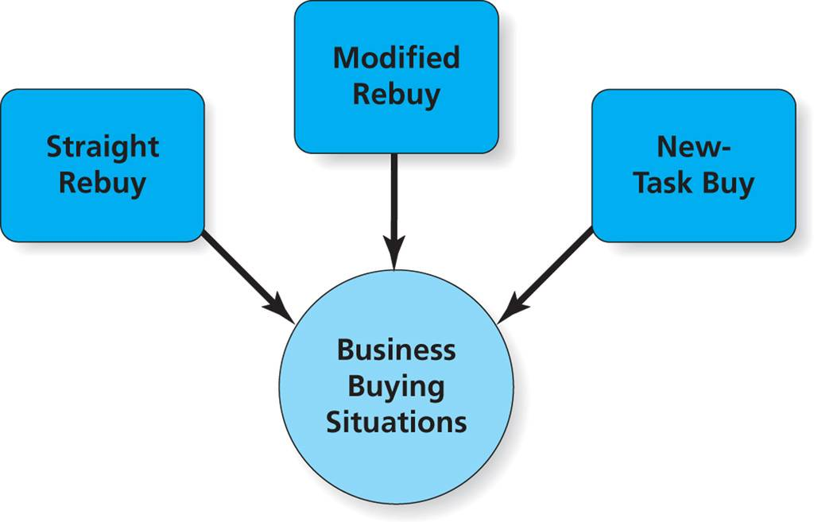
Figure 5.4
Elements of the Buy Class Framework
Copyright © 2013 Pearson Canada Inc.
5-<number>
Notes:
This slide relates to LO #3 of chapter 5.
p. 161

Slide 24
The Buy Class Framework
Straight rebuy
    Business buyers make routine purchases
    Requires minimal decision making
    Marketers should devote sufficient attention to cultivating and maintaining relationships with individuals who are in charge of ordering supplies on a regular basis, and immediately respond to any problems that might pop up
Copyright © 2013 Pearson Canada Inc.
5-<number>
Notes:
This slide relates to LO #3 of chapter 5.
p. 161 – 162
LECTURE NOTES:
The Buy Class framework identifies the degree of effort a firm needs to collect information and make a business related purchasing decision
Three buy classes exist:
Straight rebuy: Routine purchases of items bought on a regular basis fall within this class. Little time is spent on the decision, as the business merely reorders items from their existing suppliers. Supplies, such as paper or toner for the copy machine, generally fall within this class.
Marketers should devote sufficient attention to cultivating and maintaining relationships with individuals who are in charge of ordering supplies on a regular basis, and immediately respond to any problems that might pop up. The goal is to never give the customer a reason to search for an alternative provider.
Modified rebuy: Modified rebuys occur when a firm decides to shop around for a new supplier, often because they are looking for a better price, better quality, improved delivery time, or some other improvement. Products that are technological in nature often fall within this category (cell phone service, computers, etc.). Modified rebuys take more time to complete and typically involve the evaluation of more than one supplier, or even multiple product options from a given supplier. However, the buyer usually has a good idea of the general requirements they are looking for, and may limit the search to a few providers.
Buyers may search B2B websites for information, and request presentations from salespeople
New-Task Buys: New task buys are more complex, and both risk and uncertainty are high. New task buys are considered to be those in which the buyer has no previous experience. As one would expect, this means that new-task buys can be very time-consuming – multiple individuals are typically involved, and multiple vendors are evaluated. Very often the buyer needs to gather information that will help the buying teach to understand what product specifications they should be looking for, and how those specs should be evaluated.
Personal selling is critical. Testimonials from other satisfied customers can also be helpful.

Slide 25
Modified rebuy
    Business buyers shop around for suppliers and make some changes to a previously made purchase
    Requires limited decision making
    Modified rebuys take more time to complete and typically involve the evaluation of more than one supplier, or even multiple product options from a given supplier.

Slide 26
New-task buy
    Business buyers make a first-time purchase
    Requires extensive decision making
    New-task buys can be very time-consuming – multiple individuals are typically involved, and multiple vendors are evaluated
    Very often the buyer needs to gather information that will help the buying teach to understand what product specifications they should be looking for, and how those specs should be evaluated

Slide 27
Buying Situation Class Activity
Assume you are a sales manager for a firm that is a distributor of hospital equipment and supplies.
Your company offers its customers a wide range of products–everything from disposable rubber gloves to high-tech patient monitors. Purchases made by your customers include straight rebuys, modified rebuys, and new task purchases.
Your job is to explain to your new salesperson the differences among these types of purchases and how to be effective in “getting the business” for all three types of purchases.
In groups and in a role-playing exercise with your classmate, provide the needed information and advice.
<footer> Copyright © 2013 Pearson Canada Inc.
6-<number>

Slide 28
Professional Buyers and Buying Centers
Trained professional buyers typically carry out buying in business-to-business markets.
    They have titles such as
      Purchasing agents
      Procurement officers
      Directors of materials management
A buying centre, a cross-functional team of decision makers, often reach a decision
Copyright © 2013 Pearson Canada Inc.
5-<number>
Notes:
This slide relates to LO #3 of chapter 5.
p. 162 – 163
LECTURE NOTES:
B2B marketers must understand their customers, with respect to who is making the decision as well as the process which must be followed. Trained professionals carry out the buying for businesses; depending on the industry, these people may have job titles such as Purchasing Agent or Manager, Procurement Officer, or Materials Management Director.
Many times in business buying situations, a cross-functional team of decision makers, known as a buying centre, work together to reach a decision.

Slide 29
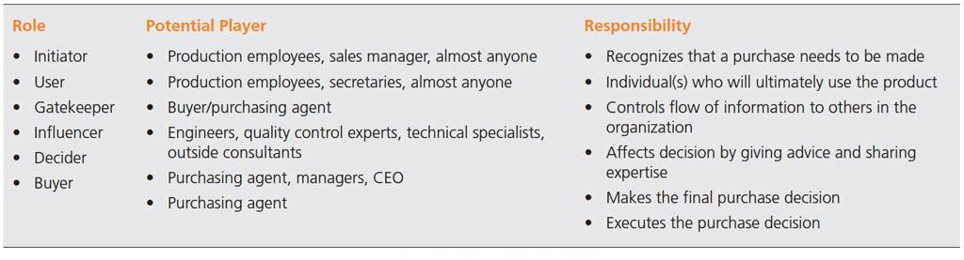
Table 5.3
Roles in the Buying Center
People in a buying centre play the following roles
Copyright © 2013 Pearson Canada Inc.
5-<number>
Notes:
This slide relates to LO #3 of chapter 5.
p. 163 - 164
LECTURE NOTES:
As mentioned earlier, several people may work together in certain buying situations, such as new task buys, in order to reach a decision.
Buying centers include all people in an organization who participate in a purchasing decision. Buying centers typically include people other than “professional buyers” – line workers, engineers, or even administrative assistants may be part of the buying center. This is because people in a buying center each play one or more roles.
The primary roles that these individuals may play are shown in the slide:
Initiator: recognizes the problem and begins the buying process
Users: individual(s) who actually need and use the product
Gatekeeper: controls the flow of information to other buying center members
Influencer: this person’s expertise and advice may influence the decision, though they may never use the product
Decider: individual who makes the final buying decision
Buyer: person who is responsible for executing the purchase
For example, the administrative assistant to the purchasing agent may be both a user of a copy machine and the gatekeeper who controls the purchasing agents’ schedule and incoming phone calls from vendor reps. In some situations, the administrative assistant may also be the initiator who first notices problems with a copier, and begins “working on the boss” to get it replaced.
DISCUSSION NOTES:
Initiator: could be students, faculty, lab manager, etc.
Users: teachers who either teach classes in the lab or students who use the lab
Gatekeeper: the individual who gathers the majority of the information and/or that person’s administrative assistant
Influencer: Individuals in the University IT department (networking), electricians or physical plant workers (wiring, set-up), etc.
Decider: Head of the college technology committee or primary grant author
Buyer: who ever controls the money – the Dean, Grant writer, Lab manager, etc.

Slide 30
It’s Debatable
Class Discussion Question
  Suppose your school is buying equipment for a computer lab.
  What individuals/job positions might fulfill each role?
Copyright © 2013 Pearson Canada Inc.
5-<number>
Notes:
This slide relates to LO #3 of chapter 5.
DISCUSSION NOTES:
Initiator: could be students, faculty, lab manager, etc.
Users: teachers who either teach classes in the lab or students who use the lab
Gatekeeper: the individual who gathers the majority of the information and/or that person’s administrative assistant
Influencer: Individuals in the University IT department (networking), electricians or physical plant workers (wiring, set-up), etc.
Decider: Head of the college technology committee or primary grant author
Buyer: members of the purchasing department or possibly who ever controls the money – the Dean, Grant writer, Lab manager, etc.

Slide 31
Answer to Discussion Question
Initiator: could be students, faculty, lab manager, etc.
Users: teachers who either teach classes in the lab or students who use the lab
Gatekeeper: the individual who gathers the majority of the information and/or that person’s administrative assistant
Influencer: Individuals in the college IT department (networking), electricians or physical plant workers (wiring, set-up), etc.
Decider: Head of the college technology committee or primary grant author
Buyer: members of the purchasing department or possibly who ever controls the money – the Dean, Grant writer, Lab manager, etc.
<footer> Copyright © 2013 Pearson Canada Inc.
6-<number>

Slide 32
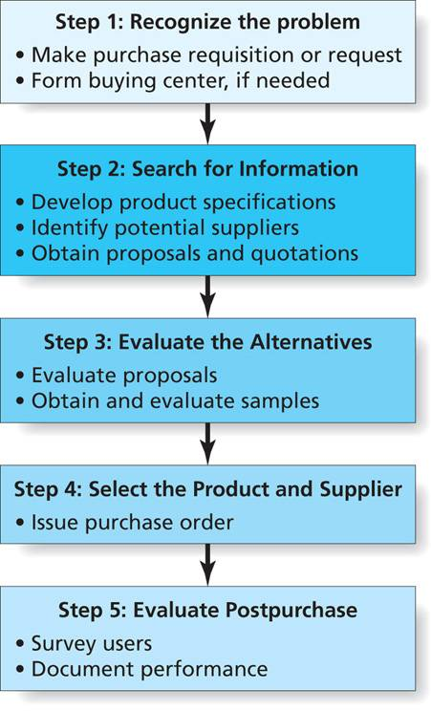
Figure 5.5
Steps in the Business Buying
Decision Process
Copyright © 2013 Pearson Canada Inc.
5-<number>
Notes:
This slide relates to LO #3 of chapter 5.
p. 164
LECTURE NOTES:
Superficially, the steps in the B2B buying process appear to be very similar to the steps in the C2B buying process, yet the execution of each step tends to be much more complex when B2B decisions are involved.
The degree to which each step within the buying process is followed varies according to the level of buy class decision. For example, if a firm runs low on paper, the buyer recognizes the problem then immediately jumps to step 4 and issues the purchase order, bypassing both the information search and alternative evaluation stages.
Modified rebuys may involve some limited information search, and the evaluation of a few suppliers.
Of course a great deal of time will be spent in stages 2 and 3 during a new-task buy.
The following slides will discuss each of these stages in more detail.

Slide 33
Step 1: Problem Recognition
Factors prompting recognition vary by buying situation (i.e., straight rebuy, modified rebuy, new-task buy)
Actions resulting from problem recognition include
  Initiation of a purchase requisition or request
  Formation of a buying center, if needed
Copyright © 2013 Pearson Canada Inc.
5-<number>
Notes:
This slide relates to LO #3 of chapter 5.
p. 164 – 165
LECTURE NOTES:
Depending upon the type of buying class, recognition of the problem stems from:
Low inventory levels (straight rebuy)
A need to replace outdated equipment (modified rebuy)
Changes in technology (modified rebuy or new-task buy)
Marketing communications (modified rebuy or new-task buy)
Actions resulting from problem recognition include:
Initiation of a purchase requisition or request, in the case of a straight rebuy
Formation of a buying center, when a new task buy or modified rebuy is underway

Slide 34
Step 2: Information Search
In this stage, buying center members
  Search for information about products and suppliers
  Develop product specifications
  Identify potential suppliers and obtain proposals (or bids)
To facilitate the buying center’s information search, marketers must provide information where and when business buyers need it
Copyright © 2013 Pearson Canada Inc.
5-<number>
Notes:
This slide relates to LO #3 of chapter 5.
p. 165 – 166
LECTURE NOTES:
In this second stage, buying center members begin their task by searching for information about products and suppliers. As part of this process, the buying center develops product specifications, which are written descriptions of the quality, size, weight, color of the item to be purchased
Identifying potential suppliers and obtaining proposals or bids is also an important part of this step.
The Internet has facilitated both distribution of the request for proposals, and provided vendors with easier access to potential customers who might benefit from their services. Many firms post their RFQs on their corporate Web site, and send notifications to their vendor list electronically. Vendors, in turn, can submit electronic submissions via the Web site. Generally, this process takes much less time when done online vs. via traditional “snail mail.”

Slide 35
Step 3: Evaluate the Alternatives
The buying center assesses proposals
  Price evaluation is a primary consideration
    Discounts policies, returned-goods policies, repair and maintenance costs, terms of payment, financing costs, warrantee
  Other factors may be considered, such as extra services or other perks
  Customer reference programs, product demos, and presentations can help sell the marketer’s products to firms
Copyright © 2013 Pearson Canada Inc.
5-<number>
Notes:
This slide relates to LO #3 of chapter 5.
p. 166
LECTURE NOTES:
Price is always a major consideration when assessing proposals, as discount policies, returned-goods policies, cost of repair, terms of maintenance, cost of financing, and more are evaluated carefully by buyers
Non-price factors, such as service extras or differences may also be evaluated. Customer reference programs are formalized processes by which customers formally share success stories and actively recommend products to other potential clients. Such programs are usually facilitated through an on-line community.
Product demonstrations, and presentations by sales representatives are critical when selling the marketer’s products to firms

Slide 36
Step 4: Select the Product and Supplier
Single sourcing
    Business practice of buying a particular product from only one supplier- Ensures consistency and quality of product
Multiple sourcing
    Buying a particular product from several different suppliers-Protects the firm from inventory and delivery problem
Reciprocity
    Trading partnership in which two firms agree to buy from one another
Copyright © 2013 Pearson Canada Inc.
5-<number>
Notes:
This slide relates to LO #3 of chapter 5.
p. 166 – 167
LECTURE NOTES:
The selection stage involves deciding which product and how many suppliers should be used.
Single sourcing: Sometimes having one supplier is more beneficial to the firm, such as when frequent deliveries are needed or when specialized products are desired. Buy relying upon a single buyer, the firm becomes a large customer to the supplier, and often this means that the firm can negotiate more favorable prices. Administrative costs may also be lower. Finally, single sourcing helps to assure the consistency and quality of products. The downside is that the firm is at the mercy of that supplier – failure to meet delivery dates could stop the production line.
Multiple sourcing: Buying from several different suppliers protects the firm from inventory or delivery problems – if one supplier has problems, the firm simply shifts business to one or more of the other suppliers. Furthermore, multiple suppliers keep each other honest in terms of pricing.
Reciprocity: On occasion, a buyer and seller will agree to be each other’s customers – this is termed “reciprocity”. While not illegal per se unless they limit free competition, the U.S. Government does frown upon this, and often determines that agreements between large firms and their suppliers are illegal.

Slide 37
Step 4: Select the Product and Supplier (ctn’d)
Outsourcing
    Obtaining outside vendors to provide goods / services that might otherwise be supplied in-house
Crowdsourcing
    Firms outsource marketing activities to a community of users
Reverse marketing
    Buyers try to find capable suppliers who will produce products according to the buyer’s specifications
Copyright © 2013 Pearson Canada Inc.
5-<number>
Notes:
This slide relates to LO #3 of chapter 5.
p. 167 – 168
LECTURE NOTES:
Outsourcing: Outsourcing, though popular, is controversial as Canadian jobs are often lost to foreign workers who provide their labor at a much cheaper rate. The quality of the outsourced work also may be inferior – many consumers have been frustrated by communication difficulties when talking to software or hardware representatives who clearly live outside Canada.
Crowdsourcing: Crowdsourcing is a little different. Whereas outsourcing is usually undertaken to save money, crowdsourcing is used when a marketer wishes to tap expertise to solve business problems that the firms own employees can’t handle.
Reverse marketing: a final unique B2B sourcing situation occurs when businesses engage in reverse marketing. In a normal B2B situation, suppliers try to find businesses that need their products or services, which they then try to persuade the firm to purchase. Reverse marketing flips this process – firms try to find suppliers who would do a good job producing the needed product, then the firm tries to convince the supplier to manufacture the needed item.

Slide 38
Crowdsourcing
Kluster.com (Brainstorming)
Namethis.com (Brand names)
Redesignme.com (Product redesign)
99designs.com (Logo design)
Copyright © 2013 Pearson Canada Inc.
5-<number>
Notes:
This slide relates to LO #3 of chapter 5.
LECTURE NOTES:
More than 40,000 designers use 99designs.com. Businesses can get a logo designed via crowdsourcing at 99designs.com by submitting a brief, and offering a contest prize to the winning designer (often as little as $150 is needed).

Slide 39
Step 5: Evaluate Postpurchase
Organizational buyers assess whether the performance of the product and the supplier live up to expectations
  Users are surveyed to determine satisfaction
  Producers may research ultimate consumer satisfaction with the buying firm’s product
  Changes in demand are analyzed
  Supplier performance is documented
Copyright © 2013 Pearson Canada Inc.
5-<number>
Notes:
This slide relates to LO #3 of chapter 5.
p. 168
LECTURE NOTES:
Organizational buyers assess the performance of the product and the supplier in one ways.
One method is to survey users to determine satisfaction with products, installation, delivery, service, and other aspects of the purchase.
It’s also not uncommon for producers of consumer goods (which are sold through retailers) to research the satisfaction of the ultimate consumers who use the product, since the demand of retailers is derived from consumers’ demand
If changes in demand occur, they are analyzed, and supplier performance is also documented

Slide 40
Step 5: Evaluate Postpurchase (ctn’d)
Metrics used by organizational buyers
  Satisfaction-Purchasing agents/Buying center members satisfaction
  Quality-Product meeting expectations
  Customer engagement- Keeping customers involved
  Purchase intentions
  Promptness and effectiveness of problem resolution
Copyright © 2013 Pearson Canada Inc.
5-<number>
Notes:
This slide relates to LO #3 of chapter 5.
p. 168
LECTURE NOTES:
Organizational buyers use a number of metrics when assessing how well a product or service performs.
(Purchasing agent/buying center member) satisfaction
Quality, and whether the product is meeting, exceeding, or falling short of expectations
Customer engagement: learning how customers got involved in the business, and finding ways to keep them involved is important
Purchase intentions: Purchase intentions often feed into demand forecasts, which in turn are used to set sales goals
The promptness and effectiveness of problem resolution is often a key factor that determines whether a firm sticks with vendor, or whether they search for new suppliers.

Slide 41
All rights reserved. No part of this publication may be reproduced, stored in a retrieval system, or transmitted, in any form or by any means, electronic, mechanical, photocopying, recording, or otherwise, without the prior written permission of the publisher. Printed in Canada.
Copyright © 2013 Pearson Canada Inc.
5-<number>

